Slide 1
Individual Project 1
Brett Tully

Slide 2

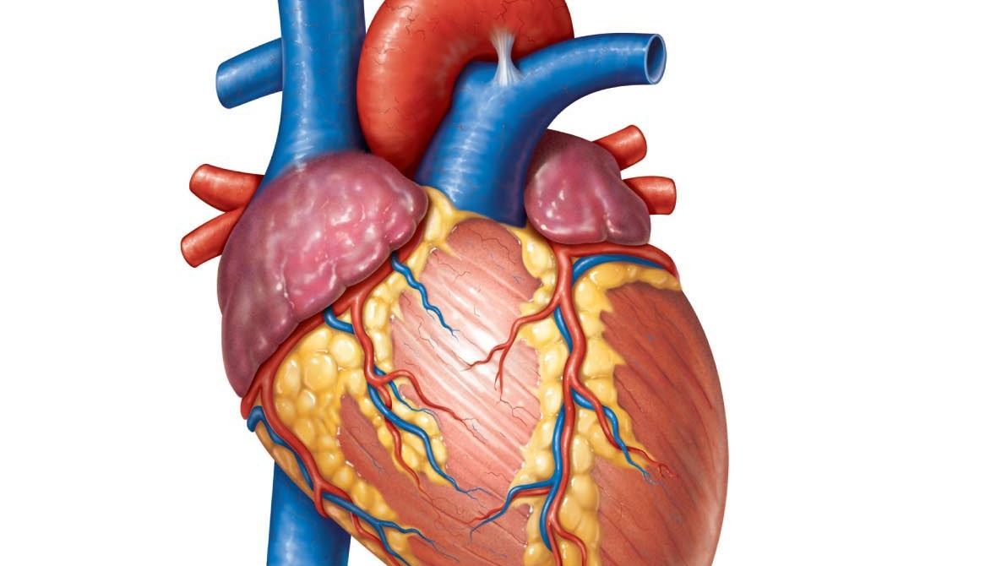
Dataset
Heart Disease Death prediction
13 columns
299 rows
0 Null values
This Photo by Unknown Author is licensed under CC BY-NC-ND

Slide 3
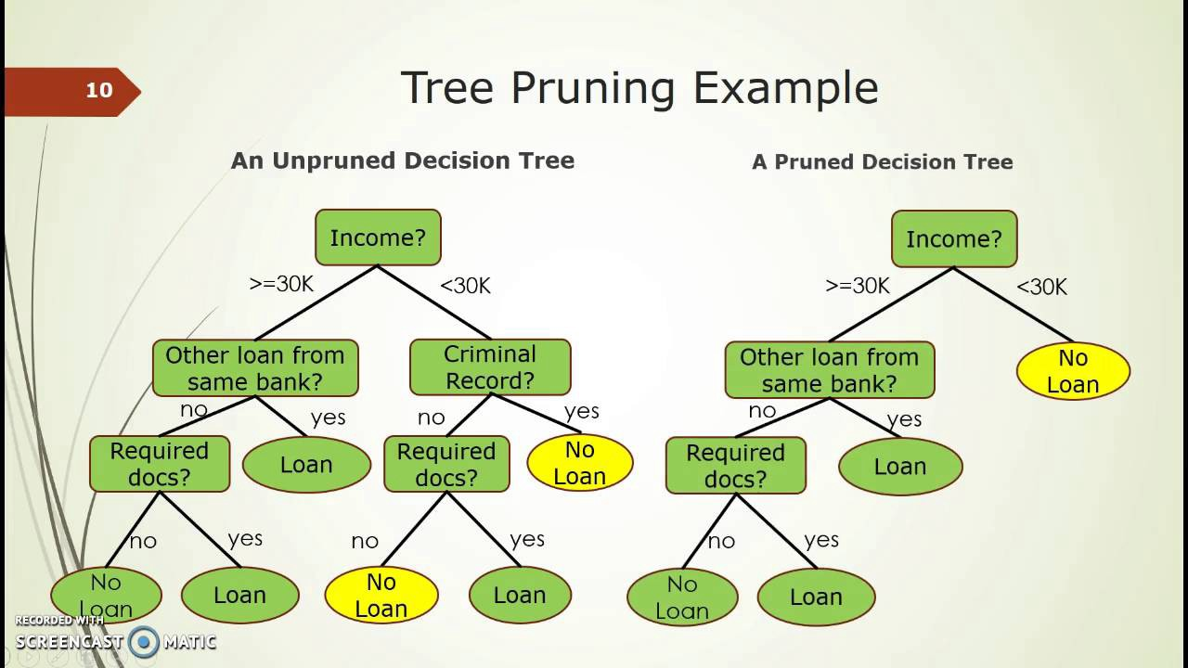
Models
Voting Classifier
Logistic Regression
Random Forest Classifier
Support Vector Classifier
Decision Tree Classifier
Bagging Classifier
Gradient Boosting Classifier
Ada Boosting Classifier.

Slide 4


